Slide 1
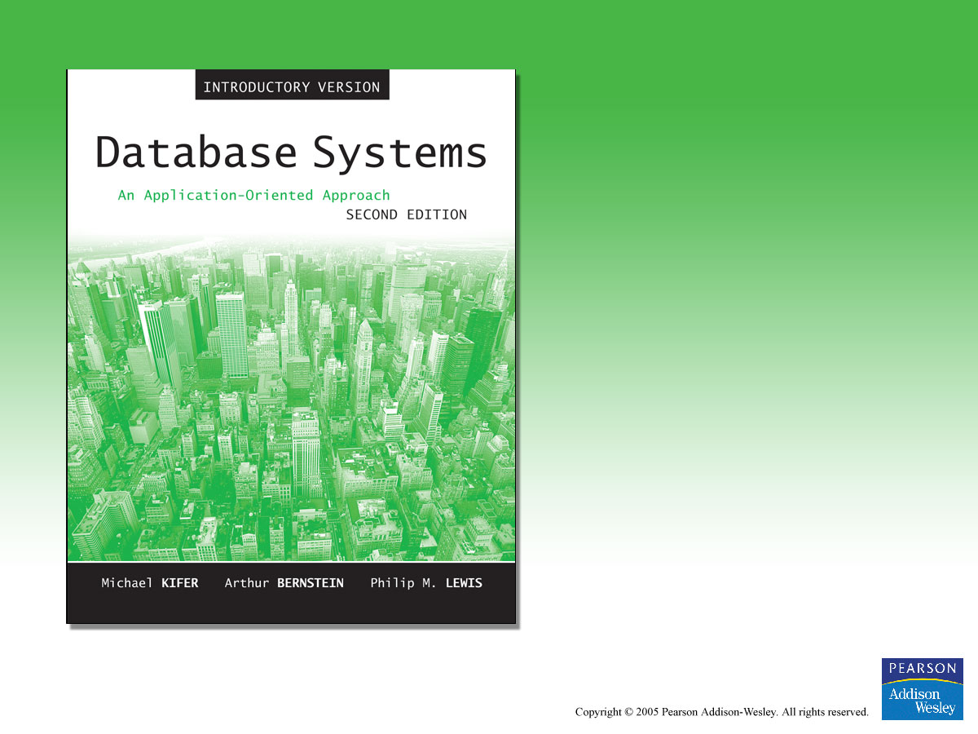
Chapter 1
Overview of Databases and Transactions

Slide 2

An Overview of Databases and Transactions
What is a Database System?
What is a Database?
Data Independence
Relational Systems, and Others
What is a Database Management System?
Why Database?
What is a Transaction?
Transaction Processing System

Slide 3
What is a Database System?
Computerized record-keeping system
Supports operations
  Add or delete files to the database
  Insert, retrieve (select), remove (delete), or change data (update) in database
Components
  Data, Hardware, Software, Users
  See Figure 1-1

Slide 4
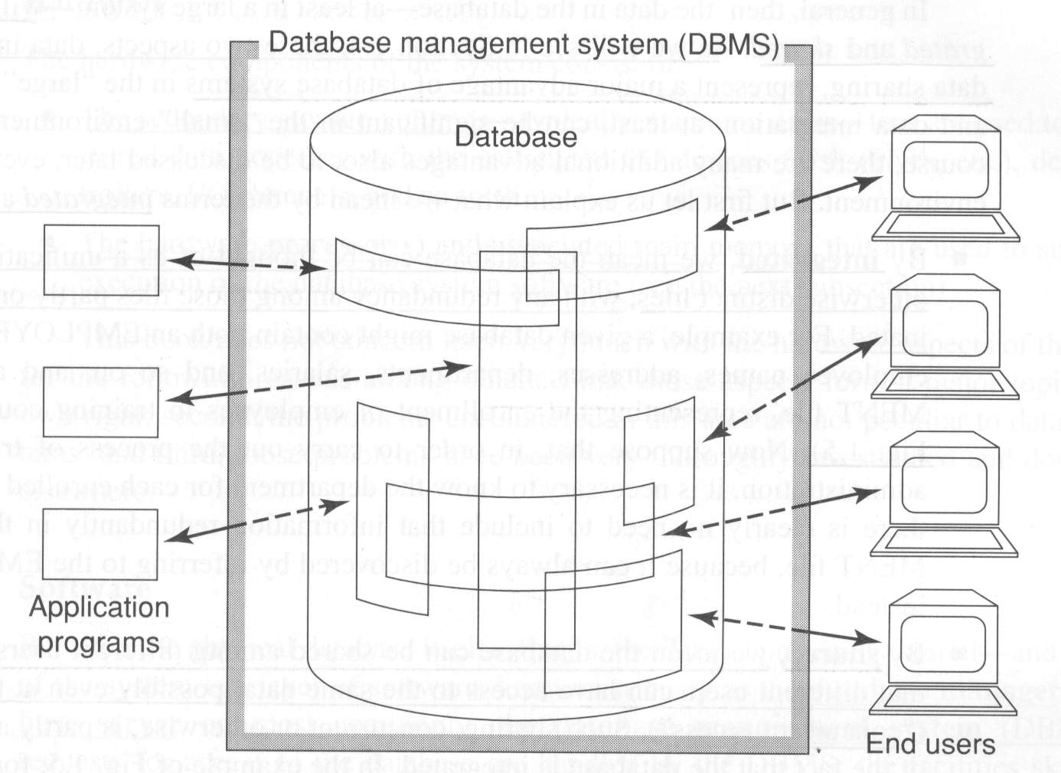
Figure 1-1 A Database System

Slide 5
Database System - Data
May support single or many users
Many users in organizations
  Data is integrated
  Data is shared
Different users will require different views

Slide 6
Database System - Hardware
Data is stored on Disk
  Direct access to subset portions
  Rapid I/O
    E.g. RAID (Redundant Array of Independent Disks)
Data operated on in main memory

Slide 7
Database System - Software
Database manager
Database server
Database management system (DBMS)
DBMS provided by specific vendor
  SQL Server (Ms. Window)
  DB2 (IBM)
  Oracle (Oracle)
  MySQL (Linux)

Slide 8
Database System - Software
DBMS is not ( but may come with)
  Application Development Tools
  Application Software
  TP Monitor (See page 1-22)
  Report Writer
  System utilities

Slide 9
Database System - Users
End users
Application programmers
Database Administrators

Slide 10
What is a Database?
Collection of data central to some enterprise
Essential to operation of enterprise
  Contains the only record of enterprise activity
An asset in its own right
  Historical data can guide enterprise strategy
  Of interest to other enterprises
State of database mirrors state of enterprise
  Collection of persistent data
Made up of Entities, Relationships, Properties
  See Figure 1.2
Implements a data model

Slide 11
Database - Persistence
Stores enterprise information over time
Outlasts the running of a computer program
Updated and retrieved in OLTP operational/production system
Offers decision support via data warehouse

Slide 12
Database - Entities and Relationships
Entity is a person, place, event or thing, about which we wish to store information
Relationship is a connection between entities, about which we wish to store information
A relationship can be considered a special case of entity

Slide 13
Database - Properties
Entities have properties
Properties are the characteristics of an entity
Properties can be simple or complex

Slide 14
Database - Data Models
Database is a collection of true propositions
Data model is an abstract, self-contained, logical representation
Implementation of the data model on a specific platform
Data model as template vs. instantiation for a specific enterprise

Slide 15
Data Models－Relational Systems
Most important innovation in database history (Proposed by Codd 1970s)
Based on logic and mathematics
Data is perceived as tables, only
Operators derive new tables from existing
A table is a “relation,” mathematically
Not pointer based (to the user)

Slide 16
Data Models－Not Relational Systems
Hierarchic
Network
Inverted List
Object
Object/Relational
Multi-dimensional

Slide 17
Data Independence
Database separates logical and physical representation of data
Allows changes to application programs without changing the structure of the underlying data
It’s a good thing

Slide 18
Materialized Data
Stored fields, collected as…
Stored records, collected as…
Stored files
Old systems, e.g., COBOL applications, directly connect to data formats
Newer database systems offer greater data independence, but could do better

Slide 19
What is a Database Management System?
A Database Management System (DBMS) is a program that manages a database:
  Supports a high-level access language (e.g. SQL).
  Application describes database accesses using that language.
  DBMS interprets statements of language to perform requested database access.

Slide 20
Why Database?
Shared data
Reduced redundancy
Reduced inconsistent data
Transaction support
Support for data integrity
Security enforcement
Support for standards
Conflicting requirements can be met

Slide 21
What is a Transaction?
When an event in the real world changes the state of the enterprise, a transaction is executed to cause the corresponding change in the database state
  With an on-line database, the event causes the transaction to be executed in real time
A transaction is an application program with special properties (ACID, discussed later) to guarantee it maintains database correctness

Slide 22
Transaction－An Example
Event
  「張三」到郵局提款機提三仟元
Enterprise
  中華郵局
Database System
  郵局存戶資料管理系統
Event Changes the Enterprise’s state
  「張三」帳戶內存款減少三仟元
Change the Database’s state (by Transaction)
  「張三」的存戶資料中存款金額改變

Slide 23
Transaction Processing System (TPS)
A TPS consists of Databases, Transactions, and TP monitor (See Fig. 1.3)
Transaction execution is controlled by a TP monitor
  Creates the abstraction of a transaction, analogous to the way an operating system creates the abstraction of a process
    MS. Windows 工作管理員
  TP monitor and DBMS together guarantee the special properties of transactions

Slide 24
Transaction Processing System
DBMS
Database
Transactions
SQL Statements
DBMS
Databases
TP Monitor
Fig. 1.3 Transaction Processing System

Slide 25
TPS Requirements -1
High Availability
  On-line => must be operational while enterprise is functioning
High Reliability
  Correctly tracks state, does not lose data, controlled concurrency
High Throughput
  Many users => many transactions/sec
Low Response Time
  On-line => users are waiting

Slide 26
TPS Requirements - 2
Long Lifetime
  Complex systems are not easily replaced
  Must be designed so they can be easily extended as the needs of the enterprise change
Security
  Sensitive information must be carefully protected since system is accessible to many users
  Authentication, authorization, encryption

Slide 27
Roles in Design, Implementation, and Maintenance of a TPS -1
System Analyst
  Specifies system using input from customer; provides complete description of functionality from customer’s and user’s point of view
Database Designer
  Specifies structure of data that will be stored in database
Application Programmer
  Implements application programs (transactions) that access data and support enterprise rules

Slide 28
Roles in Design, Implementation and Maintenance of a TPS - 2
Project Manager
  Responsible for the successful completion of the implementation project
    Prepare schedules and budget, assigns people to tasks, and monitors day-to-day project operation
User
  Cause the execution of individual transactions
    Usually by interacting through some GUI
    E.g. ATM 提款機

Slide 29
Roles in Design, Implementation and Maintenance of a TPS - 3
Database Administrator
  Maintains database once system is operational
    Space allocation, performance optimization, database security, …
System Administrator
  Maintains transaction processing system
    Monitors interconnection of HW and SW modules, deals with failures and congestion, …

Slide 30
OLTP vs. OLAP
On-line Transaction Processing (OLTP)
  Day-to-day handling of transactions that result from enterprise operation
  Maintains correspondence between database state and enterprise state
On-line Analytic Processing (OLAP)
  Analysis of information (historical data) in a database for the purpose of making management decisions

Slide 31
OLAP
Analyzes historical data (terabytes) using complex queries
Due to volume of data and complexity of queries, OLAP often uses a data warehouse
Data Warehouse (offline)
  Repository of historical data generated from OLTP or other sources
Data Mining
  Use of warehouse data to discover relationships that might influence enterprise strategy

Slide 32
Examples - Supermarket
OLTP
  Event is 3 cans of soup and 1 box of crackers bought; update database to reflect that event
OLAP
  Last winter in all stores in northeast, how many customers bought soup and crackers together?
Data Mining
  Are there any interesting combinations of foods that customers frequently bought together?

